Slide 1

Deep Learning-Based Crowd Density Estimation and Anomaly Detection System Using Radial Basis Function Network (RBFN) with Open CV
MLA0403-DEEP LEARNING
Guided BY
Dr.A.M.Arul Raj Professor
Students Name
G Saswanth (192425150)
p.Mokshith (192425149)
partha saradhi
Likith reddy

Slide 2
Abstract
Developed an AI-based system for real-time crowd density estimation and anomaly detection.
Used OpenCV for video capture, preprocessing, and human detection.
Applied the Radial Basis Function Network (RBFN) for crowd density classification.
Classified crowd density into Low, Medium, and High levels.
Detected abnormal crowd behavior such as overcrowding and panic movement.
Generated instant alerts for security personnel during emergencies.
Reduced manual monitoring and improved surveillance efficiency.
Enhanced public safety through intelligent video surveillance.

Slide 3
Introduction
Rapid urbanization has increased the need for intelligent crowd monitoring systems.
Manual CCTV monitoring is time-consuming and prone to human errors.
Deep learning enables automatic crowd analysis with higher accuracy.
OpenCV performs image processing and feature extraction from surveillance videos.
RBFN efficiently estimates crowd density using extracted features.
The system continuously monitors crowd movement in real time.
Automatic alerts help authorities respond quickly to abnormal situations.
Suitable for smart city and public security applications

Slide 4
Literature Review
S.No | Year | Author | Title of Journal / Book | Methodology Used | Algorithm Used | Key Findings
1 | 2022 | Zizhu Fan et al. | Crowd Counting and Density Estimation | Image density analysis | CNN | Improved crowd counting accuracy (ScienceDirect)
2 | 2022 | Haoyue Bai et al. | Deep Learning-Based Single Image Crowd Counting | Density map estimation | Deep CNN | Effective density estimation (ScienceDirect)
3 | 2024 | Lijia Deng et al. | Deep Learning in Crowd Counting | Feature and density analysis | CNN / Deep Learning | Better crowd analysis (IET Research)
4 | 2025 | Md. Haidar Sharif et al. | Deep Crowd Anomaly Detection | Video anomaly analysis | CNN / Autoencoder | Detects abnormal crowd behavior (Doi.org)
5 | 2025 | Guangshuai Gao et al. | Deep Learning Methods for Density Estimation and Crowd Counting | Density map generation | CNN-based Models | Accurate crowd density estimation (Doi.org)

Slide 5
Problem Statement
Manual monitoring of CCTV cameras is time-consuming and prone to human error.
Existing surveillance systems struggle to accurately estimate crowd density in highly crowded environments.
Delayed detection of abnormal crowd behavior can lead to accidents, stampedes, and security threats.
Traditional methods often fail under poor lighting, occlusions, and complex crowd movements.
There is a need for an intelligent system that can automatically estimate crowd density and detect anomalies in real time.
The proposed system uses OpenCV and Radial Basis Function Network (RBFN) to provide accurate crowd monitoring and instant alert generation.

Slide 6
Existing System
Raditional crowd monitoring systems mainly rely on manual CCTV surveillance by security personnel.
Computer vision techniques such as Haar Cascade and HOG are used for basic human detection.
Deep learning models like CNN are used for crowd counting and density estimation.
Most existing systems require high computational resources and powerful hardware.
Detection accuracy decreases in dense crowds due to occlusion and overlapping people.
Many systems are unable to detect abnormal crowd behavior in real time.

Slide 7
Proposed System
he proposed system uses OpenCV and Radial Basis Function Network (RBFN) for intelligent crowd monitoring.
It captures live CCTV or recorded video and preprocesses the frames for analysis.
Human detection and feature extraction are performed using computer vision techniques.
The RBFN model estimates crowd density and classifies it into Low, Medium, and High levels.
The system continuously detects abnormal crowd behavior such as overcrowding, panic movement, and sudden gatherings.

Slide 8



Overall System Architecture
End-to-end pipeline: from live video capture to real-time density classification, anomaly alerts, and reporting
Video Input
(Live CCTV / Recorded Feed)
Preprocessing (OpenCV: Denoise, Resize, Normalize)
Human Detection &
Feature Extraction
RBFN Crowd Density
Estimation (Low/Med/High)
Anomaly Detection
(Overcrowding, Panic Movement)
Alert Generation
(Instant Security Notification)
Dashboard
(Visualization & Reports)

Slide 9
SDG-Sustainble development Goal
Relevant SDG: Goal 11 – Sustainable Cities and Communities
Supports SDG 11 by improving safety in public spaces through intelligent crowd monitoring.
Reduces the risk of overcrowding, stampedes, and other crowd-related accidents.
Enables real-time surveillance for better emergency response and disaster management.
Enhances public security in airports, railway stations, shopping malls, and stadiums.
Promotes the development of smart city infrastructure using AI and computer vision.
Assists authorities in managing large public gatherings more efficiently.
Improves the quality of urban life by ensuring safer public environments.
Contributes to sustainable and resilient cities through advanced surveillance technology.

Slide 10
Design&Module Planning
Module 1: Video Acquisition and Image Preprocessing
Module 2: Human Detection and Feature Extraction
Module 3: Crowd Density Estimation Using Radial Basis Function Network (RBFN) Module 4: Anomaly Detection and Alert Generation
Module 5: Dashboard, Visualization and Report Generation

Slide 11
Module 1: Video Acquisition and Image Preprocessing
This module is responsible for capturing live CCTV or recorded surveillance videos and converting them into individual frames for analysis. Using OpenCV, the system performs image preprocessing techniques such as resizing, noise removal, brightness adjustment, and normalization to improve image quality.
Proper preprocessing helps increase the accuracy of human detection and crowd analysis in later stages.
Capture live CCTV or recorded surveillance videos.
Extract and preprocess video frames using OpenCV.
Remove noise and enhance image quality for better analysis and converting to radial images.
Prepare high-quality input data for the next processing stage.

Slide 12
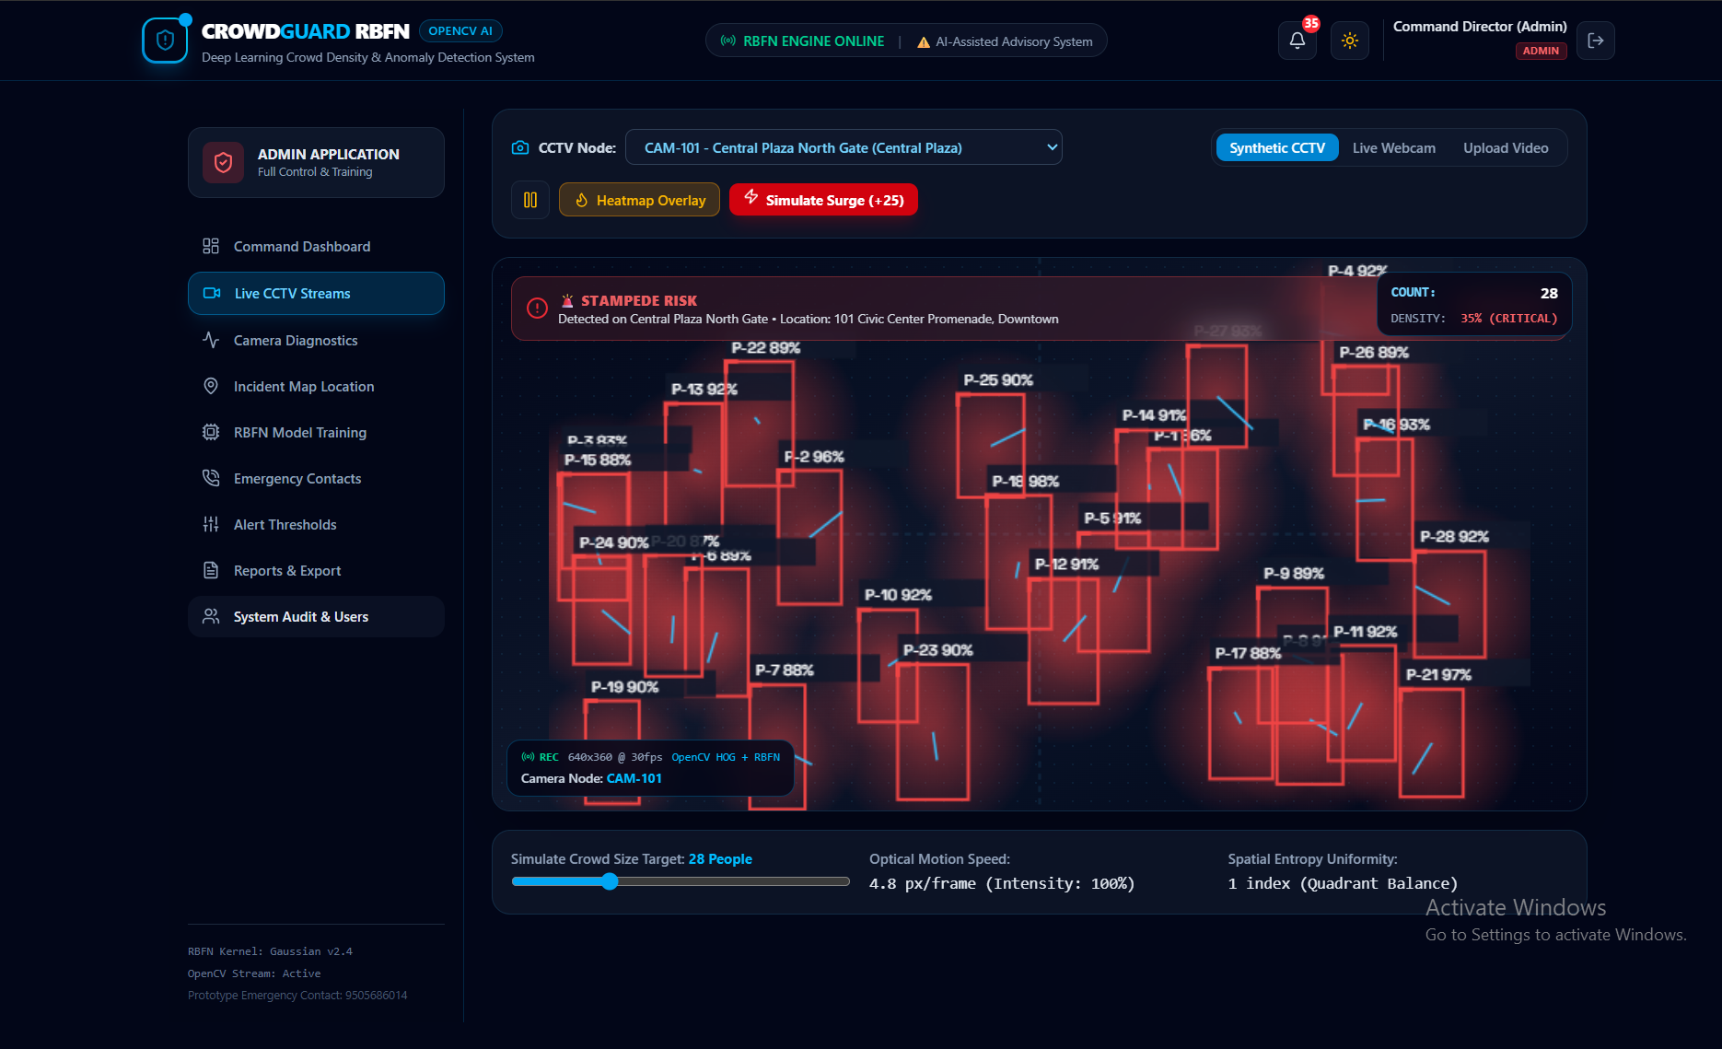

Slide 13
Module 2: Human Detection and Feature Extraction
This module detects people present in each video frame using computer vision techniques. After detection, important features such as the number of people, their positions, movement patterns, and spatial information are extracted. These features are used by the RBFN model to estimate crowd density accurately.
Detect human objects from surveillance video frames.
Extract movement, position, and crowd-related features.
Count the number of people in each frame.
Prepare extracted features for crowd density estimation

Slide 14
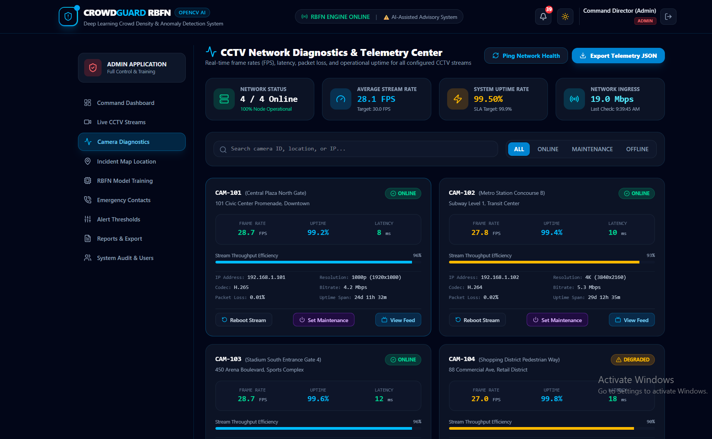

Slide 15
Module 3: Crowd Density Estimation Using Radial Basis Function Network (RBFN)
This module uses the Radial Basis Function Network (RBFN) to estimate crowd density based on the extracted features. The trained model analyzes crowd characteristics and classifies density into Low, Medium, or High levels. The results are displayed in real time for effective crowd monitoring and management.
Train and test the Radial Basis Function Network model.
Estimate crowd density from extracted features.
Classify density into Low, Medium, and High levels.
Display accurate crowd density results in real time.

Slide 16
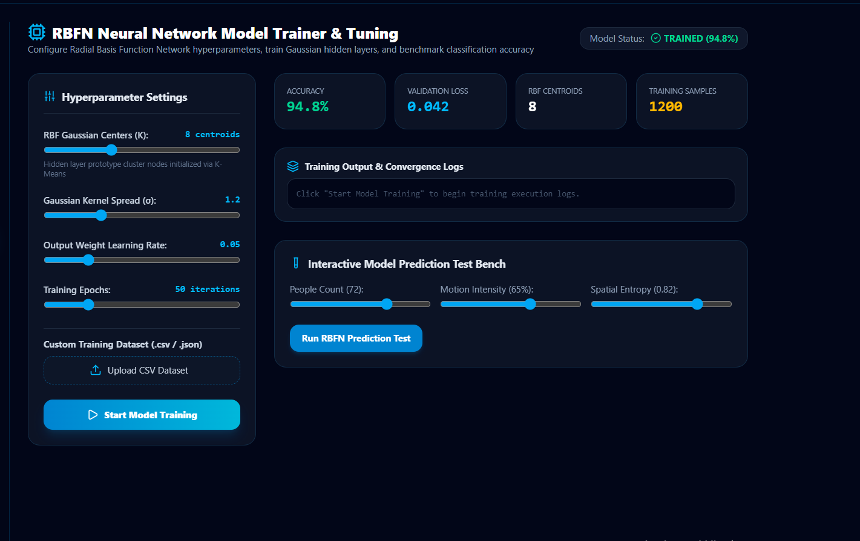

Slide 17
Module 4: Anomaly Detection and Alert Generation
This module continuously analyzes crowd movement and behavior to detect abnormal situations such as overcrowding, sudden gatherings, panic movement, or restricted-area intrusion. When an unusual event is detected, the system immediately generates warning alerts, enabling security personnel to respond quickly and prevent potential accidents.
Monitor crowd behavior continuously for unusual activities.
Detect overcrowding, panic movement, and abnormal events.
Generate instant alerts for security personnel.
Improve emergency response and public safety.

Slide 18
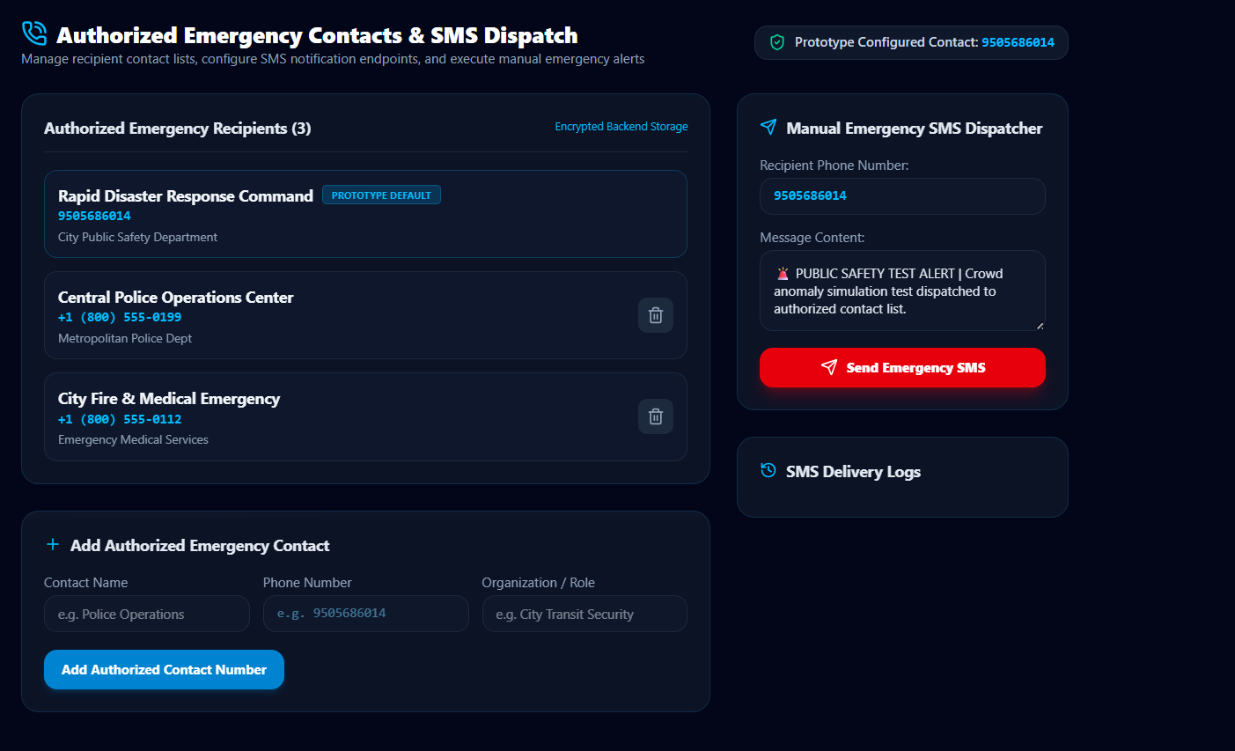

Slide 19
Module 5: Dashboard, Visualization and Report Generation
This module provides a user-friendly dashboard that displays live surveillance video, crowd density levels, and anomaly detection results. It also stores surveillance logs and generates analytical reports that help authorities review crowd conditions and make better management decisions.
Display live crowd monitoring through an interactive dashboard.
Show real-time crowd density and anomaly statistics.
Store surveillance records and event history.
Generate reports for analysis and decision-making

Slide 20
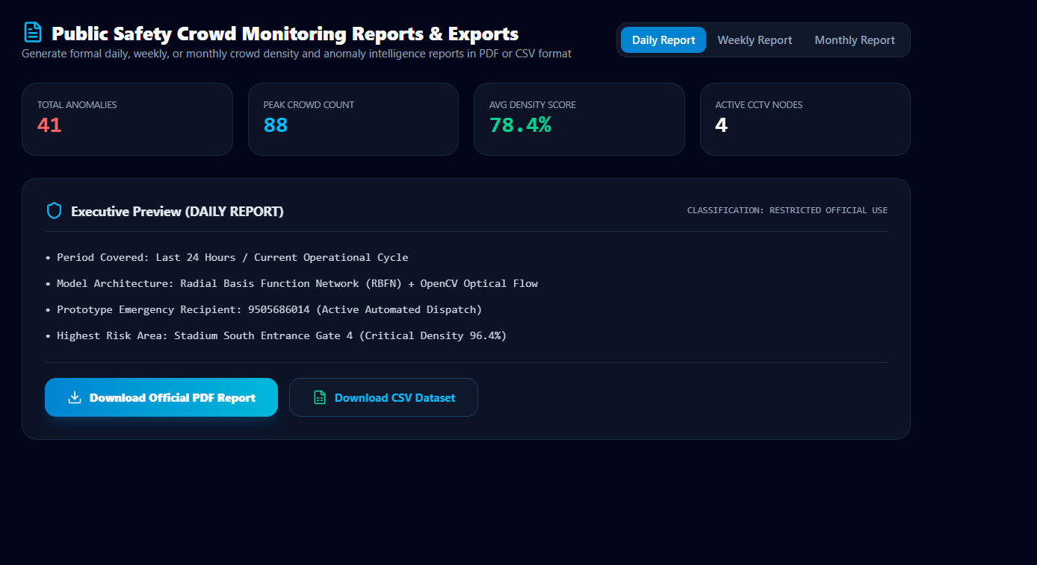

Slide 21
System Debugging & Optimization
Debugging: Identify and fix errors in the crowd detection, density estimation, and anomaly detection modules.
Performance Testing: Check system accuracy, processing speed, memory usage, and response time.
Optimization: Reduce unnecessary image-processing operations and improve RBFN prediction speed.
OpenCV Optimization: Use efficient frame processing and resizing to achieve faster video analysis.
Model Optimization: Tune RBFN parameters to improve crowd-density and anomaly-detection accuracy.
Final Testing: Test the complete system with different crowd sizes and real-time video inputs.

Slide 22
Full System Testing
Full System Testing
Test the complete system using real-time crowd videos.
Verify crowd detection and density estimation accuracy.
Test RBFN-based prediction under different crowd sizes.
Check anomaly detection and alert generation.
Measure accuracy, processing speed, and response time.
Confirm that all modules work correctly together without errors.

Slide 23
Solution Design and Implementation
Solution Design and Implementation
Design the system using OpenCV, Deep Learning, and RBFN.
Capture and preprocess real-time video frames.
Detect people and generate crowd density information.
Use RBFN to classify crowd density levels.
Detect abnormal crowd activities and generate alerts.
Implement and integrate all modules into a real-time monitoring system.

Slide 24
Results and Recommendations
Results and Recommendations
The system successfully estimates crowd density from video frames.
RBFN classifies crowd levels effectively.
OpenCV enables real-time video processing.
The system detects abnormal crowd activities and generates alerts.
Recommended to use larger datasets for better accuracy.
Future work can improve real-time performance and anomaly detection.

Slide 25
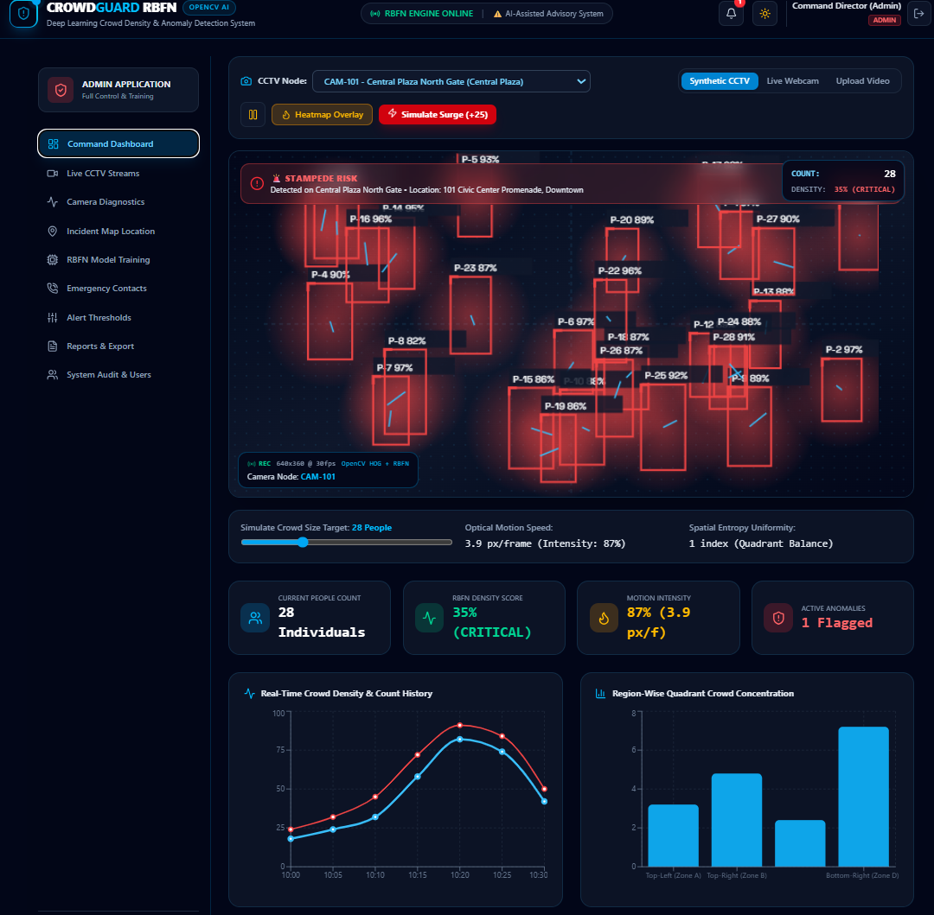
Implementation

Slide 26
Future Enhancement
Improve crowd-density estimation accuracy using advanced deep-learning models.
Enhance RBFN performance through parameter optimization.
Add real-time CCTV integration for continuous monitoring.
Detect more anomalies such as stampedes, fights, sudden crowd movement, and overcrowding.
Add real-time SMS, email, or mobile notifications for emergencies.
Develop a web/mobile dashboard for live crowd monitoring.

Slide 27
Limitations
Accuracy may decrease in highly crowded scenes.
Poor lighting and low-quality videos can affect detection.
Occlusion and camera angles may reduce accuracy.
Real-time processing may require high computational power.
The system may produce false alarms or incorrect anomaly detection.

Slide 28
conclusion
Developed an intelligent system for real-time crowd density estimation and anomaly detection.
Used OpenCV for video processing, human detection, and feature extraction.
Applied the Radial Basis Function Network (RBFN) for accurate crowd density classification.
Detected abnormal crowd behavior such as overcrowding and panic movement.
Generated instant alerts to improve emergency response and public safety.
Reduced manual surveillance through automated intelligent monitoring.
Improved accuracy, efficiency, and reliability of crowd management.
Suitable for smart cities, airports, railway stations, stadiums, and other public places.

Slide 29
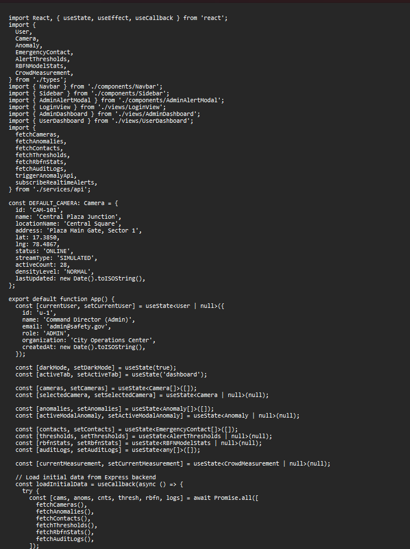
Appendix-Sample code

Slide 30
Reference
Zhang, Y., Zhou, D., Chen, S., Gao, S., & Ma, Y. (2016). Single-Image Crowd Counting via Multi-Column Convolutional Neural Network. CVPR.
Li, Y., Zhang, X., & Chen, D. (2018). CSRNet: Dilated Convolutional Neural Networks for Understanding Highly Congested Scenes. CVPR.
Sindagi, V. A., & Patel, V. M. (2019). A Survey of Recent Advances in CNN-Based Single Image Crowd Counting and Density Estimation. Pattern Recognition Letters.
Cohen, N., & Hoshen, Y. (2020). Detecting and Tracking People in Crowded Scenes Using Deep Learning. IEEE.
Cheng, Z.-Q., Dai, Q., Li, H., Song, J., Wu, X., & Hauptmann, A. G. (2022). Rethinking Spatial Invariance of Convolutional Networks for Object Counting. ICCV.

